Slide 1
BCT 2305: Data Communications
Lecture 2( Week 4-6) : Data Transmission

Slide 2
Outline
Data Transmission-Physical Layer and Media - data, signals and signal characteristics, frequency and time domains, analog and digital transmission – base band, broad band – impairments – attenuation, distortion, noise – analog to digital – PCM– Transmission modes – parallel, serial , asynchronous, synchronous – digital to analog – ASK, FSK, PSK – analog to analog – AM, FM, PM – Chanel, capacity, Multiplexing – FDM, WDM, TDM. Transmission Media . Guided Media – twisted pair, co-axial, fiber optic – unguided – wireless communication, switching techniques

Slide 3
What is data communication?
Not to be confused with telecommunication which is—
Any process that permits the passage from a sender to one or more receivers of information of any nature, delivered in any easy to use form by any electromagnetic system.
Data communication-
Defined as a subset of telecommunication involving the transmission of data to and from computers and components of computer systems.
More specifically data communication is transmitted via mediums such as wires, coaxial cables, fiber optics, or radiated electromagnetic waves such as broadcast radio, infrared light, microwaves, and satellites.

Slide 4
Data Communications contd
The term telecommunication means communication at a distance. The word data refers to information presented in whatever form, as agreed upon by the parties creating and using the data.
Data communications are the exchange of data between two devices via some form of transmission medium such as a wire cable.

Slide 5
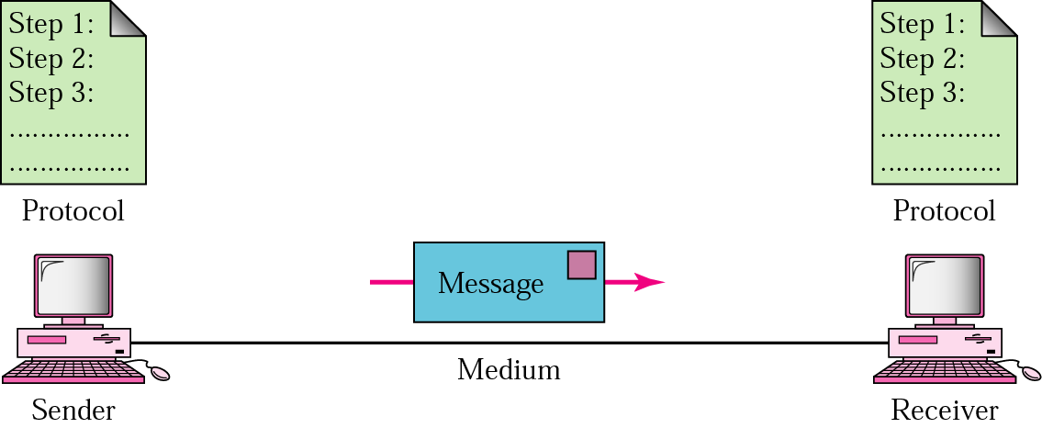
Five Components of Data Communication
Message
Sender
Receiver
Medium
Protocol

Slide 6
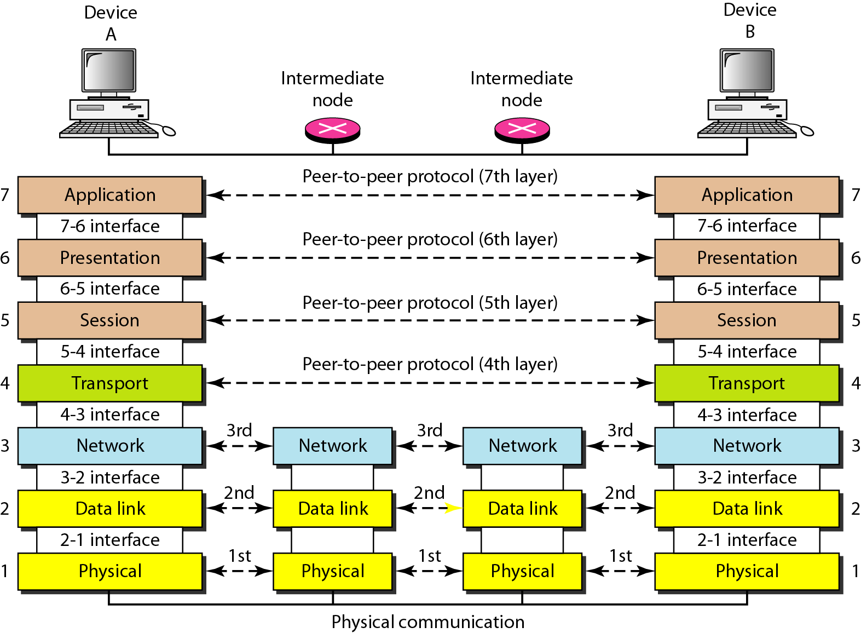
Transmission

Slide 7
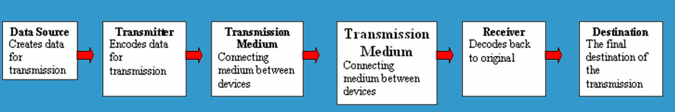
5 Basic Components
Every communication system has 5 basic requirements
Data Source (where the data originates)
Transmitter (device used to transmit data)
Transmission Medium (cables or non cable)
Receiver (device used to receive data)
Destination (where the data will be placed)

Slide 8
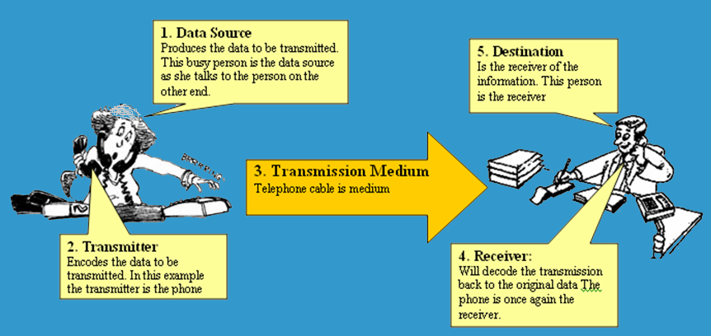
5 Basic Components

Slide 9
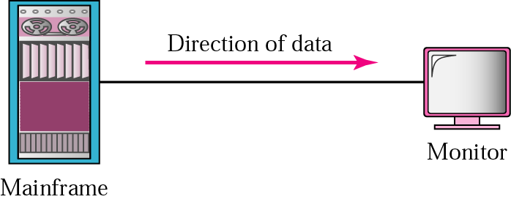


Transmission Direction
Simplex
Half Duplex
Full Duplex

Slide 10
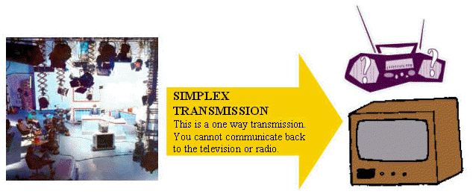
Transmission Direction
- simplex: One direction only

Slide 11
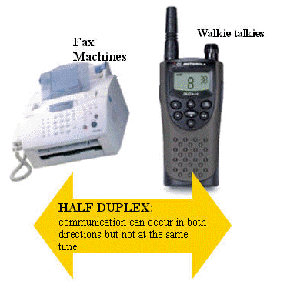
Half Duplex Transmission
half duplex: Both directions but only one direction at a time

Slide 12
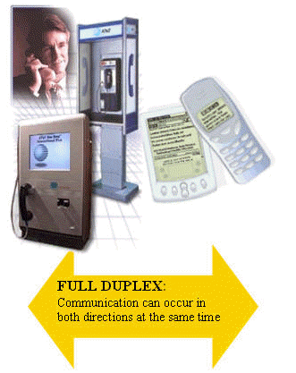
Full Duplex Transmission
full duplex: send and receive both directions at once

Slide 13
Signal Transmission
Any information carrying transmission may be:
analog or digital
Serial or parallel

Slide 14
Serial Transmission
Data is transmitted, on a single channel, one bit at a time one after another
- Much faster than parallel because of way bits processed (e.g. USB and SATA drives)
Sender transmitted
Receiver received
1
0
0
1
1
0
0
1

Slide 15
Parallel Transmission
each bit has it’s own piece of wire along which it travels
- often used to send data to a printer
1
0
0
1
Receiver received
Sender transmitted
1
0
0
1
All bits are sent simultaneously

Slide 16
Digital Data Transmission
Each single bit can be represented by a signal element.
Each signal element takes some time to send.
Bit rate: the number of bits that can be sent out per unit of time.
1
1
0
0
1
1
1
0
0
time

Slide 17
The objective of data transmission ?
Maximize the data rate: number of bits that the system can transmit in a unit of time
within an acceptable bit error rate
Why there could be bit errors?
The signal received by the receiver is different from the signal sent from the sender
Usually, if data rate becomes higher, it is more difficult for the receiver to recognize the signal
higher data rate results in higher bit error rate
In order to achieve high data rate with low bit error rate, we need to study the principle of data communications. The ideal balance.

Slide 18
The Relationship Between Frequency and Bits Per Second
Higher Data Transfer Rates
How do you send data faster?
Use a higher frequency signal (make sure the medium can handle the higher frequency
Use a higher number of signal levels
In both cases, noise can be a problem

Slide 19
Data and Signals
Data are entities that convey meaning (computer files, music on CD, results from a system)
Signals are the electric or electromagnetic encoding of data (telephone conversation, web page download)
Computer networks and data/voice communication systems transmit signals
Data and signals can be analog or digital

Slide 20
Analog vs. Digital
Analog is a continuous waveform, with examples such as (naturally occurring) music and voice
It is harder to separate noise from an analog signal than it is to separate noise from a digital signal (imagine the following waveform is a symphony with noise embedded)

Slide 21
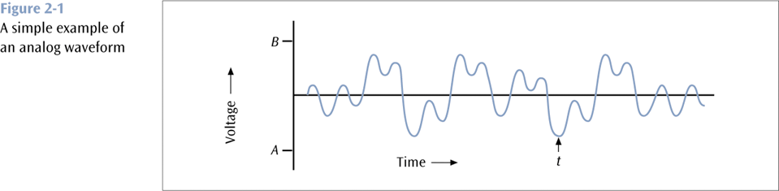
Analog vs. Digital (continued)

Slide 22
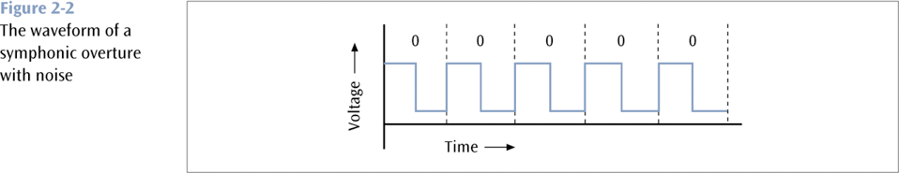
Analog vs. Digital (continued)

Slide 23
Analog vs. Digital (continued)
Digital is a discrete or non-continuous waveform with examples such as computer 1s and 0s
Noise in digital signal
You can still discern a high voltage from a low voltage
Too much noise – you cannot discern a high voltage from a low voltage

Slide 24
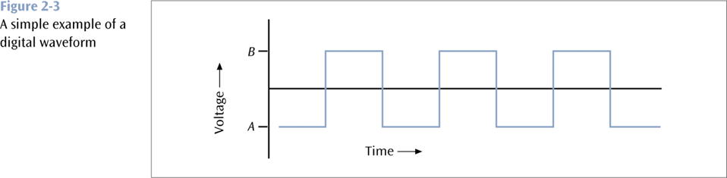
Analog vs. Digital (continued)

Slide 25
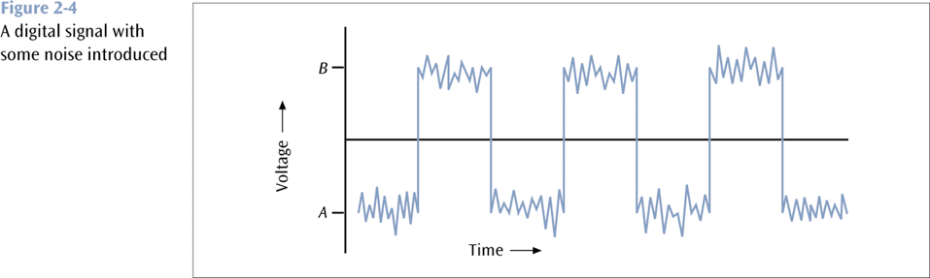
Analog vs. Digital (continued)

Slide 26
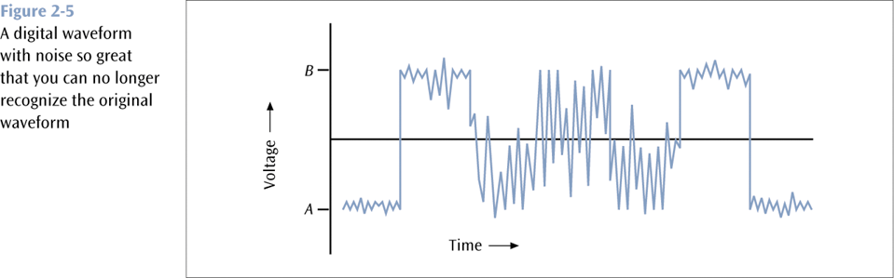
Analog vs. Digital (continued)

Slide 27
Fundamentals of Signals
All signals/ EM waves have three components:
Amplitude
Frequency
Phase
and can be expressed as a sinusoid or cosinoid of the from S=A cos(2 πft +ϕ)
And travel in composite form each unique signal is related to the fundamental frequencies
A - Amplitude
The height of the wave above or below a given reference point
S=5 cos(2 π5t + π/4) here 5V is amplitude

Slide 28
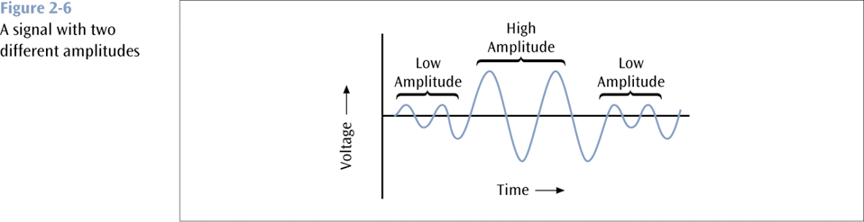
Fundamentals of Signals (continued)

Slide 29
Fundamentals of Signals (continued)
f - Frequency
The number of times a signal makes a complete cycle within a given time frame; frequency is measured in Hertz (Hz), or cycles per second e.g. S=5cos(2π5t) here f=5Hz
Spectrum – Range of frequencies that a signal spans from minimum to maximum e.g. S=S₁+S₂ where S₁=cos(2π5t) and S₂=cos(2π7t). Here spectrum SP={5Hz,7Hz}.
Bandwidth – Absolute value of the difference between the lowest and highest frequencies of a signal. In the above example bandwidth is BW=2Hz.
Consider an average voice
The average voice has a frequency range of roughly 300 Hz to 3100 Hz
The spectrum would be 300 – 3100 Hz
The bandwidth would be 2800 Hz

Slide 30
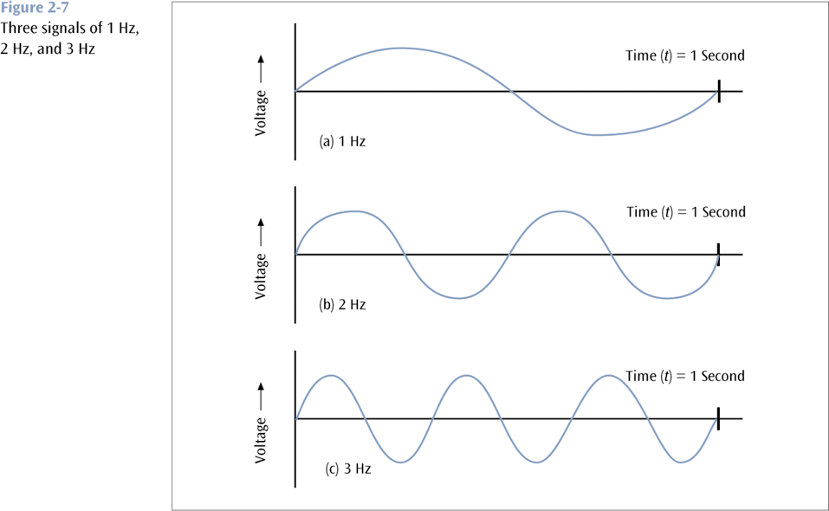
Fundamentals of Signals (continued)

Slide 31
Fundamentals of Signals (continued)
ϕ - Phase
The position of the waveform relative to a given moment of time or relative to time zero, e.g. S₁=cos(2π5t) and S₂=cos(2π5t + π/2). Here S₁ has phase ϕ=0 and S₂ has phase ϕ= π/2.
A change in phase can be any number of angles between 0 and 360 degrees
Phase changes often occur on common angles, such as π/4=45, π/2=90, 3π/4=135, etc.

Slide 32
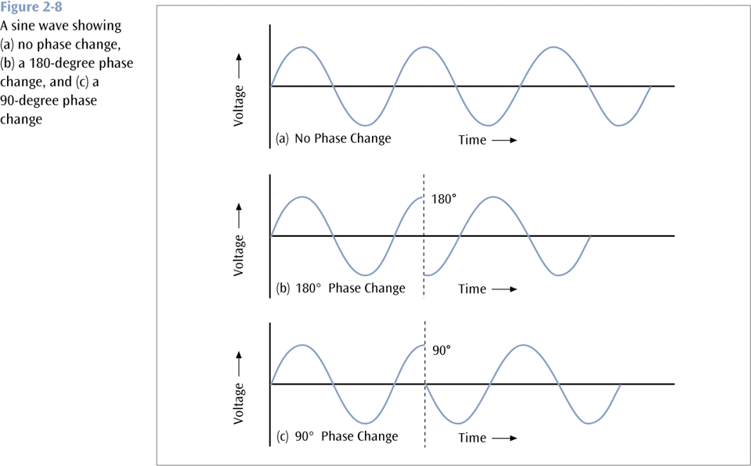
Fundamentals of Signals (continued)

Slide 33
Assignment 1
Show using an elaborate example how you can determine the phase difference of any two signal
( Due today 17th Sep 2015 at 11.59 PM) by email. Ps indicate: BCT 2305 Assignment 1 + regno on the subject line)

Slide 34
Data Codes
The set of all textual characters or symbols and their corresponding binary patterns is called a data code
There are three common data code sets:
EBCDIC
ASCII
Unicode

Slide 35
Unicode
Each character is 16 bits
A large number of languages / character sets
For example:
T equals 0000 0000 0101 0100
r equals 0000 0000 0111 0010
a equals 0000 0000 0110 0001

Slide 36
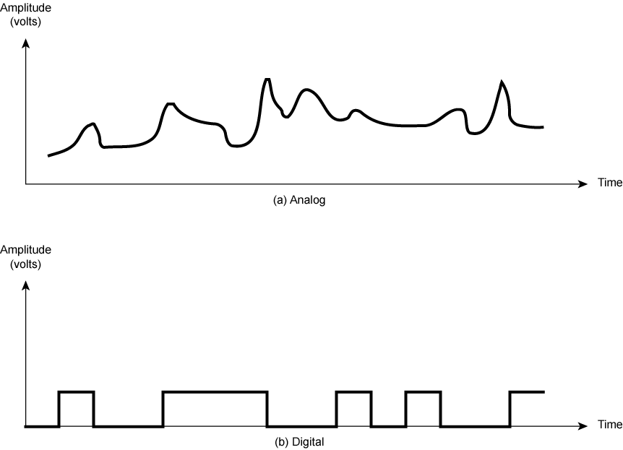
Analogue & Digital Signals

Slide 37
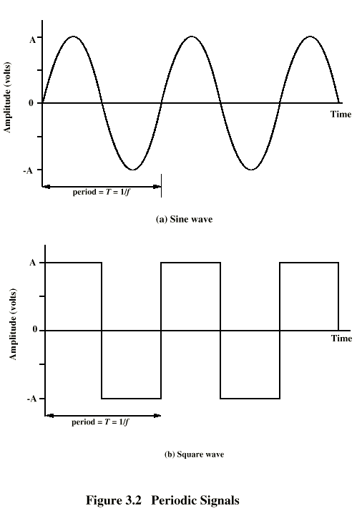
Periodic Signals
Concept of periodic signal
The same signal pattern repeats over time.
Otherwise, a signal is aperiodic.
Sine Wave: represented by three parameters, s(t)=Asin(2π ft+φ)
Peak Amplitude (A)
maximum strength of signal
measured in volts
Frequency (f)
Rate of change of signal
Hertz (Hz) or cycles per second
Period = time for one repetition (T)
T = 1/f
Phase (φ)
Relative position in time within a single period of a signal
Figure (a) displays the value of a signal at a given point in space as a function of time.

Slide 38
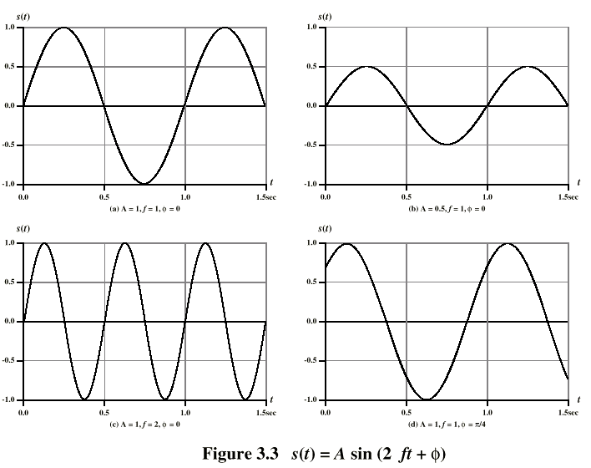
Varying Sine Waves s(t) = A sin(2πft +Φ)

Slide 39
Analog and Digital Data Transmission
The two terms “analog” and “digital” are used frequently in the following three contexts:
Data
Entities that convey meaning or information
Signals
electromagnetic representations of data
Transmission
The communication of data by the propagation and processing of signals
Analog: continuous
Digital: discrete

Slide 40
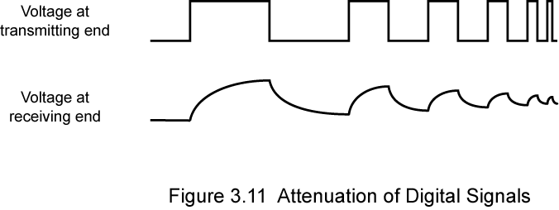
Advantages & Disadvantages of Digital Signals
Generally cheaper than analog signaling
Less susceptible to noise
Suffer more from attenuation!
Pulses become rounded and smaller
Leads to loss of information

Slide 41
Converting Data into Signals
There are four main combinations of data and signals:
Analog data transmitted using analog signals
Digital data transmitted using digital signals
Digital data transmitted using analog signals
Analog data transmitted using digital signals

Slide 42
Transmitting Analog Data with Analog Signals
In order to transmit analog data, you can modulate the data onto a set of analog signals
Broadcast radio and television are two very common examples of this

Slide 43
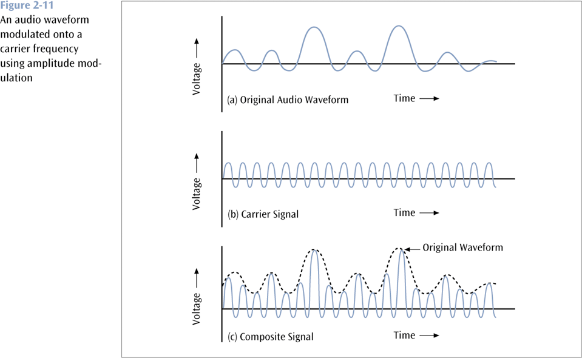
Transmitting Analog Data with Analog Signals (continued)

Slide 44
Transmitting Digital Data with Analog Signals
Three basic techniques:
Amplitude shift keying
Frequency shift keying
Phase shift keying

Slide 45
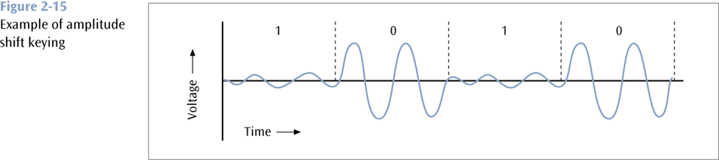
Amplitude Shift Keying (continued)

Slide 46
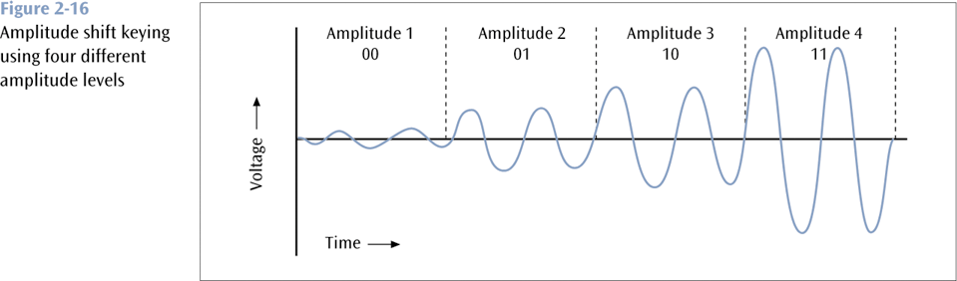
Amplitude Shift Keying (continued)

Slide 47
Frequency Shift Keying
One frequency encodes a 0 while another frequency encodes a 1 (a form of frequency modulation)

Slide 48
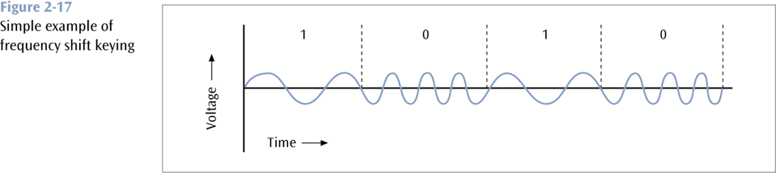
Frequency Shift Keying (continued)

Slide 49
Phase Shift Keying
One phase change encodes a 0 while another phase change encodes a 1 (a form of phase modulation)

Slide 50
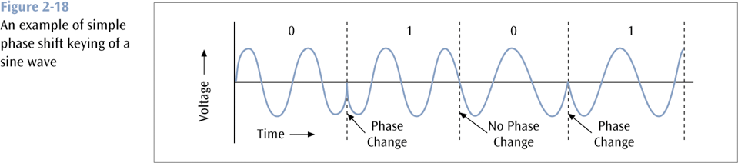
Phase Shift Keying (continued)

Slide 51
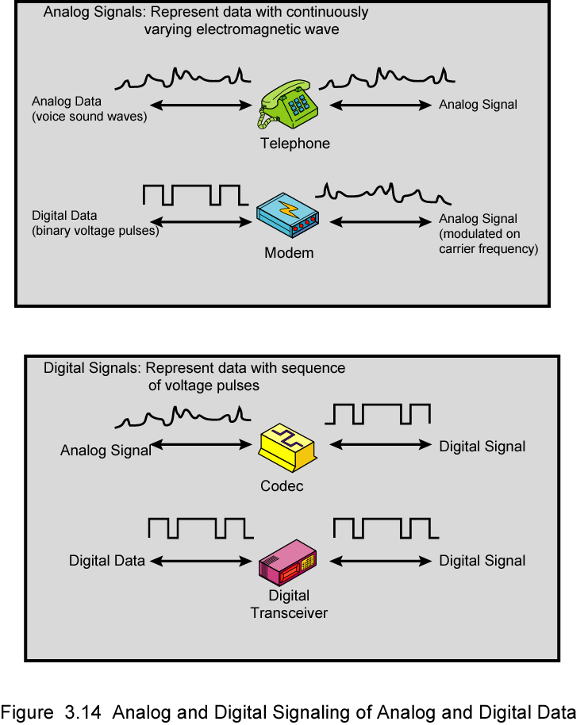
Analog Signals Carrying Analog and Digital Data

Slide 52
Digital Signals Carrying Analog and Digital Data
Analog Data

Slide 53
Transmission Impairments
With any communications system, the signal that is received may differ from the signal that is transmitted, due to various transmission impairments.
Consequences:
For analog signals: degradation of signal quality
For digital signals: bit errors
The most significant impairments include
Attenuation and attenuation distortion
Delay distortion
Noise

Slide 54
Attenuation
Attenuation: signal strength falls off with distance.
Depends on medium
For guided media, the attenuation is generally exponential and thus is typically expressed as a constant number of decibels per unit distance.
For unguided media, attenuation is a more complex function of distance and the makeup of the atmosphere.
Three considerations for the transmission engineer:
A received signal must have sufficient strength so that the electronic circuitry in the receiver can detect the signal.
The signal must maintain a level sufficiently higher than noise to be received without error.
These two problems are dealt with by the use of amplifiers or repeaters.

Slide 55
Attenuation Distortion
(Following the previous slide)
3. Attenuation is often an increasing function of frequency. This leads to attenuation distortion:
some frequency components are attenuated more than other frequency components.
Attenuation distortion is particularly noticeable for analog signals: the attenuation varies as a function of frequency, therefore the received signal is distorted, reducing intelligibility.

Slide 56
Delay Distortion
Delay distortion occurs because the velocity of propagation of a signal through a guided medium varies with frequency.
Various frequency components of a signal will arrive at the receiver at different times, resulting in phase shifts between the different frequencies.
Delay distortion is particularly critical for digital data
Some of the signal components of one bit position will spill over into other bit positions, causing intersymbol interference, which is a major limitation to maximum bit rate over a transmission channel.

Slide 57
Noise
For any data transmission event, the received signal will consist of the transmitted signal, modified by the various distortions imposed by the transmission system, plus additional unwanted signals that are inserted somewhere between transmission and reception.
The undesired signals are referred to as noise, which is the major limiting factor in communications system performance.
Four categories of noise:
Thermal noise
Crosstalk
Impulse noise

Slide 58
Noise contd
Thermal noise (or white noise)
Due to thermal agitation of electrons
It is present in all electronic devices and transmission media, and is a function of temperature.
Cannot be eliminated, and therefore places an upper bound on communications system performance.

Slide 59
Noise contd
Crosstalk
It is an unwanted coupling between signal paths. It can occur by electrical coupling between nearby twisted pairs.
Typically, crosstalk is of the same order of magnitude as, or less than, thermal noise.
Impulse noise
Impulse noise is non-continuous, consisting of irregular pulses or noise spikes of short duration and of relatively high amplitude.
It is generated from a variety of cause, e.g., external electromagnetic disturbances such as lightning.
It is generally only a minor annoyance for analog data.
But it is the primary source of error in digital data communication.

Slide 60
Channel Capacity: Recall the objectives of data Transmision
Maximize the data rate: number of bits that the system can transmit in a unit of time
within an acceptable bit error rate
Why there could be bit errors?
The signal received by the receiver is different from the signal sent from the sender
Usually, if data rate becomes higher, it is more difficult for the receiver to recognize the signal
higher data rate results in higher bit error rate
In order to achieve high data rate with low bit error rate, we need to study the principle of data communications. The ideal balance.

Slide 61
Channel Capacity
The maximum rate at which data can be transmitted over a given communication channel, under given conditions, is referred to as the channel capacity.
Data rate
The rate in bits per second (bps) at which data can be communicated
Bandwidth
In cycles per second, or Hertz
Constrained by transmitter and the nature of the medium
Error rate
The rate at which errors occur, where an error is the reception of a 1 when a 0 was transmitted or the reception of a 0 when a 1 was transmitted.
We would like to make as efficient use as possible of a given bandwidth, i.e., we would like to get as high a data rate as possible at a particular limit of error rate for a given bandwidth.

Slide 62
Two Formulas
Problem: given a bandwidth, what data rate can we achieve?
Nyquist Formula
Assume noise free
Shannon Capacity Formula
Assume white noise

Slide 63
Nyquist Formula
Assume a channel is noise free.
Nyquist formulation: if the rate of signal transmission is 2B, then a signal with frequencies no greater than B is sufficient to carry the signal rate.
Given bandwidth B, highest signal rate is 2B. Hence C=2B for binary signals
Why is there such a limitation?
due to intersymbol interference, such as is produced by delay distortion.
There are 2 peak points in one cycle... Period. So you sample at twice the frequency to get a good sample!
Given binary signal (two voltage levels), the maximum data rate supported by B Hz is 2B bps.
One signal represents one bit

Slide 64
Nyquist Formula
Signals with more than two levels can be used, i.e., each signal element can represent more than one bit. i.e more than one sample
E.g., if a signal has 4 different levels, then a signal can be used to represents two bits: 00, 01, 10, 11
With multilevel signaling, the Nyquist formula becomes:
C = 2B log₂M
M is the number of discrete signal levels that the sample is allowed to vary( M=2^{L} where L=number of bits used to represent the sample , B is the given bandwidth, C is the channel capacity in bps.
How large can M be?
The receiver must distinguish one of M possible signal elements.
Noise and other impairments on the transmission line will limit the practical value of M.
Nyquist’s formula indicates that, if all other things are equal, doubling the bandwidth doubles the data rate.

Slide 65
Shannon Capacity Formula
Now consider the relationship among data rate, noise, and error rate.
Faster data rate shortens each bit, so burst of noise affects more bits
At given noise level, higher data rate results in higher error rate
All of these concepts can be tied together neatly in a formula developed by Claude Shannon.
For a given level of noise, we would expect that a greater signal strength would improve the ability to receive data correctly.
The key parameter is the SNR: Signal-to-Noise Ratio, which is the ratio of the power in a signal to the power contained in the noise.
Typically, SNR is measured at receiver, because it is the receiver that processes the signal and recovers the data.
For convenience, this ratio is often reported in decibels
SNR = signal power / noise power
SNR_{db}⁼ 10 log₁₀ (SNR)

Slide 66
Shannon Capacity Formula
Shannon Capacity Formula:
C = B log₂(1+SNR)
Only white noise is assumed. Therefore it represents the theoretical maximum that can be achieved. Note that for large values of SNR, the value of 1+SNR equates to SNR hence
C=B log₂SNR
SNR_{dB} = 10 log₁₀ SNR
This is referred to as error-free capacity.
Some remarks:
Given a level of noise, the data rate could be increased by increasing either signal strength or bandwidth.
As the signal strength increases, so do the effects of nonlinearities in the system which leads to an increase in intermodulation noise.
Because noise is assumed to be white, the wider the bandwidth, the more noise is admitted to the system. Thus, as B increases, SNR decreases.

Slide 67
Example –Binary signal
Nyquist Capacity
Consider a voice channel being used, via modem, to transmit digital data. Assume a bandwidth of B = 3100Hz. Then the Nyquist capacity, C, of the channel is:
C = 2B = 2×3100 = 6200b/s If we now assume M = 8, a value used for some modems, then C = 2B log(M) = 2B×3 = 18600b/s.

Slide 68
Example
Consider an example that relates the Nyquist and Shannon formulations. Suppose the spectrum of a channel is between 3 MHz and 4 MHz, and SNR_{dB} = 24dB. So,
B = 4 MHz – 3 MHz = 1 MHz
SNR_{dB} = 24 dB = 10 log10(SNR) → SRN = 251
Using Shannon’s formula, the capacity limit C is:
C = 10⁶ x 1og₂(1+251) ≈ 8 Mbps.
If we want to achieve this limit, how many signaling levels are required at least?
By Nyquist’s formula: C = 2Blog₂M
We have 8 x 10⁶ = 2 x 10⁶ x log₂M → M = 16.

Slide 69
Example
Suppose the spectrum of a channel is between 3MHz and 4MHz (hence bandwidth of 1MHz) and the SNR = 24dB. Then absolute SNR = 10(24/10) = 251. Using Shannons formula: C = 1MHz log2(1 + SNR) = 106 ×log2(1 + 251) ≈ 8×106 = 8Mb/s This is a theoretical limit, but if we assume we can reach it, then how? Nyquist’s theorem also tells us:
C = 2B log2(M) So 8Mb/s = 2×1MHz×log2(M). So we need M = 16. That is, our signal needs to be able to carry 16 diﬀerent levels.

Slide 70
Composite Signals and Fourier Series
To approximate a square wave with frequency f and amplitude A, the terms of the series are as follows:
Frequencies: f, 3f, 5f, 7f, …
Signals with an integer multiple of a base frequency f are called “harmonics”
Amplitudes of sine waves with these frequencies:
Note that amplitudes of higher frequencies decrease rapidly.
Frequency | Amplitude
f | 4A/π
3f | 4A/3π
5f | 4A/5π
7f | 4A/7π

Slide 71
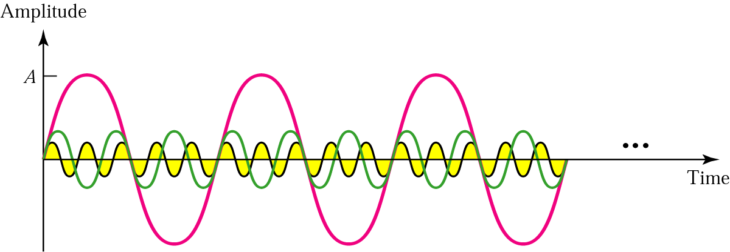
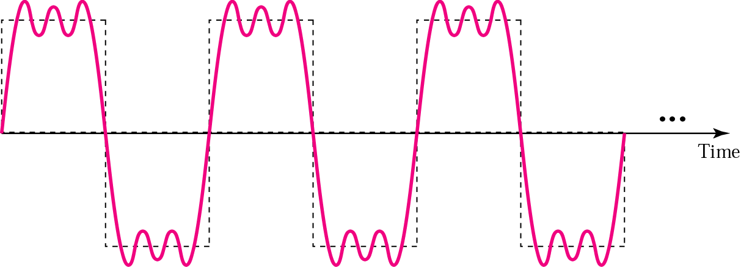
Composite analog signals

Slide 72
Signal-to-noise ratio
The ratio S / N is the “signal to noise” ratio.
Units are often reported in “bels”, which is the logarithm (base 10) of the ratio
Decibels: 10 times the above value
Example 35 dB = 3.5 bels
The ratio can also be expressed as a pure number:
S/N is 1000, meaning that the signal power is 1000 times the noise power.

Slide 73
Few things to remember
Using the calculator how to find
log₂ (x) = ln (x) / ln (2)
log₁₀ (x) = ln (x) / ln (10)
How to convert S/N to/from dB
y db = 10 log ₁₀ (S/N)
10 ^{y/10} => S/N
Also,
y = log _{n} x really means x = n ^{y}

Slide 74
Solving Questions using Nyquist Formula
C = 2B log₂ L
Given C in bits/second and L (a number). Find B in Hz?
Example : C = 1 × 10⁶ b/s and L = 8
1 × 10⁶ = 2 B log₂ (8)
B = 1.6 × 10⁷ Hz

Slide 75
Solving Questions using Nyquist Formula
C = 2B log₂ L
2. Given C in bits/second and B in Hz. Find L?
Example : C = 7 × 10⁶ b/s and B = 1.75 × 10⁶ Hz
7 × 10⁶ = 2 (1.75 × 10⁶) log₂ (L)
L = 4

Slide 76
Solving Questions using Nyquists Formula
C = 2B log₂ L
3. Given B in Hz and L (in number). Find C in b/s?
Example : B = 6 × 10⁶ Hz and L = 12
C = 2 (6 × 10⁶) log₂ (12)
C = 4.3 × 10⁷ b/s

Slide 77
Solving Questions using Shannon’s Formula
C = B log₂ S/N
1. Given C in b/s and B in Hz. Find S/N ?
Example : C = 5 × 10⁶ b/s and B = 1.25 × 10⁶
5 × 10⁶ = (1.25 × 10⁶ ) log₂ (1+ S/N)
S/N = 16
Another variation is to find S/N in decibels.
S/N = 16 = log₁₀ (16) = 1.20 bels
S/N = 1.20 * 10 = 12 decibels

Slide 78
Solving Questions using Shannon’s Formula
C = B log₂ S/N
2. Given C in b/s and S/N. Find B in Hz?
Example : C = 1 × 10⁹ Hz and S/N = 40 dB
First convert 40 dB to S/N ratio then apply Shannon’s Formula
1 × 10⁹ = B log₂ (1 + 1.0×10⁴)
B = 75.25 × 10⁶ Hz

Slide 79
Solving Questions using Shannon’s Formula
C = B log₂ S/N
3. Given B in Hz and S/N. Find C in b/s?
Example : B = 4 × 10⁹ Hz and S/N = 1023 (not in dB)
C = 4 × 10⁹ log₂ (1 + 1023)
C = 4 × 10¹⁰ b/s

Slide 80
Solving Questions using Shannon’s Formula
C = B log₂ S/N
4. Given B in Hz and S/N in dB. Find C in b/s?
Example : B = 8 × 10⁶ Hz and S/N = 45 dB
First convert decibels to S/N ratio => 10 ^{40/10}
C = 8 × 10⁶ log₂ (1 + 1.0 × 10⁴)
C = 8 × 10¹⁰ × 1.33 × 10¹
C = 1.64 × 10¹² b/s

Slide 81
Question 1
What is the maximum theoretical capacity in bits per second of a coaxial cable band with a frequency spectrum of 50 MHz to 100 MHz and a signal to noise ratio of 40 dB?

Slide 82
Question 1
What is the maximum theoretical capacity in bits per second of a coaxial cable band with a frequency spectrum of 50 MHz to 100 MHz and a signal to noise ratio of 40 dB?
Shannon’s formula:
First, determine S/N:
40 = 10 × log₁₀(S/N)
4 = log₁₀(S/N)
1.0×10⁴ = S/N
Determine B: 1.0×10⁸ – 5.0×10⁷ ⁼ 5.0 × 10⁷ b/s
C = B log₂ S/N

Slide 83
Question 2
We have a channel with a 1 MHz bandwidth. The ratio S/N is 63. What is the appropriate bit rate and number of signal levels?

Slide 84
Question 2
We have a channel with a 1 MHz bandwidth. The ratio S/N is 63. What is the appropriate bit rate and number of signal levels?
First, use Shannon’s formula to find the upper data rate at 1 signal level:
C = B log₂ S/N

Slide 85
Question 2
We have a channel with a 1 MHz bandwidth. The ratio S/N is 63. What is the appropriate bit rate and number of signal levels?
Next, use the Nyquist formula to obtain the number of signal levels L:
C = 2B log₂ L

Slide 86
Question 2
We have a channel with a 1 MHz bandwidth. The ratio S/N is 63. What is the appropriate bit rate and number of signal levels?
Next, use the Nyquist formula to obtain the number of signal levels L:
C = 2B log₂ L
6 × 10⁶ = 2 × 1 × 10⁶ log₂(L)
3 = log₂(L)
8 = L
Therefore, 8 signal levels can be used to send bits at 6 × 10⁶ b/s over this channel.

Slide 87
Question 3
Suppose that an FM radio station is allocated 200 KHz of bandwidth, and wants to digitally broadcast stereo CD music which means that 16 bits need to be sent at a sample rate of 44,100 samples per second for each of 2 sound channels. How many signal levels are needed?
C = 2B log₂ L
44100x16x2 = 2Blog₂L

Slide 88
3-5 DATA RATE LIMITS
A very important consideration in data communications is how fast we can send data, in bits per second, over a channel. Data rate depends on three factors:
1. The bandwidth available B
2. The level of the signals we use M
3. The quality of the channel (the level of noise)

Slide 89

Note
Increasing the levels of a signal increases the probability of an error occurring, in other words it reduces the reliability of the system. Why??

Slide 90
Capacity of a System
The bit rate of a system increases with an increase in the number of signal levels we use to denote a symbol.
A symbol can consist of a single bit or “n” bits.
The number of signal levels M = 2^{n}.
As the number of levels goes up, the spacing between level decreases -> increasing the probability of an error occurring in the presence of transmission impairments.

Slide 91
Nyquist Theorem
Nyquist gives the upper bound for the bit rate of a transmission system by calculating the bit rate directly from the number of bits in a symbol (or signal levels) and the bandwidth of the system (assuming 2 symbols/per cycle and first harmonic).
Nyquist theorem states that for a noiseless channel:
C = 2 B log₂2^{n}
C= capacity in bps
B = bandwidth in Hz

Slide 92
Example 3.34
Consider a noiseless channel with a bandwidth of 3000 Hz transmitting a signal with two signal levels. The maximum bit rate can be calculated as

Slide 93
Example 3.35
Consider the same noiseless channel transmitting a signal with four signal levels (for each level, we send 2 bits). The maximum bit rate can be calculated as

Slide 94
Example 3.36
We need to send 265 kbps over a noiseless channel with a bandwidth of 20 kHz. How many signal levels do we need?
Solution
We can use the Nyquist formula as shown:
Since this result is not a power of 2, we need to either increase the number of levels or reduce the bit rate. If we have 128 levels, the bit rate is 280 kbps. If we have 64 levels, the bit rate is 240 kbps.

Slide 95
Example 3.37
Consider an extremely noisy channel in which the value of the signal-to-noise ratio is almost zero. In other words, the noise is so strong that the signal is faint. For this channel the capacity C is calculated as
This means that the capacity of this channel is zero regardless of the bandwidth. In other words, we cannot receive any data through this channel.

Slide 96
Example 3.38
We can calculate the theoretical highest bit rate of a regular telephone line. A telephone line normally has a bandwidth of 3000. The signal-to-noise ratio is usually 3162. For this channel the capacity is calculated as
This means that the highest bit rate for a telephone line is 34.860 kbps. If we want to send data faster than this, we can either increase the bandwidth of the line or improve the signal-to-noise ratio.

Slide 97
Example 3.39
The signal-to-noise ratio is often given in decibels. Assume that SNR_{dB} = 36 and the channel bandwidth is 2 MHz. The theoretical channel capacity can be calculated as

Slide 98


Example 3.40
For practical purposes, when the SNR is very high, we can assume that SNR + 1 is almost the same as SNR. In these cases, the theoretical channel capacity can be simplified to
For example, we can calculate the theoretical capacity of the previous example as

Slide 99
Example 3.41
We have a channel with a 1-MHz bandwidth. The SNR for this channel is 63. What are the appropriate bit rate and signal level?
Solution
First, we use the Shannon formula to find the upper limit.

Slide 100
Example 3.41 (continued)
The Shannon formula gives us 6 Mbps, the upper limit. For better performance we choose something lower, 4 Mbps, for example. Then we use the Nyquist formula to find the number of signal levels.

Slide 101
Note
The Shannon capacity gives us the upper limit; the Nyquist formula tells us how many signal levels we need.

Slide 102
Type of Questions
Given B and S/N ratio
- find C
- find L based on C
Given B, L
- find C
- find required S/N
- find S/N in dB

Slide 103
KEY POINTS
All of the forms of information can be represented by electromagnetic signals. Depending on the transmission medium and the communications environment, either analog or digital signals can be used to convey information.
Any electromagnetic signals, analog or digital, is made up of a number of constituent frequencies. A key parameter that characterizes the signal is bandwidth, which is the width of the range of frequencies that comprises the signal. In general , the greater the bandwidth of the signal, the greater its information-carrying capacity.

Slide 104
KEY POINTS
A major problem in designing a communications facility is transmission impairment, including attenuation, distortion, and various types of noise. For analog signals, transmission impairments introduce random effects that degrade the quality of the received information and may affect intelligibility. For digital signals, transmission impairments may cause bit errors at the receiver.
Ctechgroupa2012@gmail.com,

Slide 105
KEY POINTS
The designer of a communications facility must deal with four factors: the bandwidth of the signal, the data rate that is used for digital information, the amount of noise and other impairments, and the level of error rate that is acceptable. The bandwidth is limited by the transmission medium and the desire to avoid interference with other nearby signals. Because bandwidth is a scarce resource, we would like to maximize the data rate that is achieved in a given bandwidth. The data rate is limited by the bandwidth, the presence of impairments, and the error rate that is acceptable.

